Slide 1


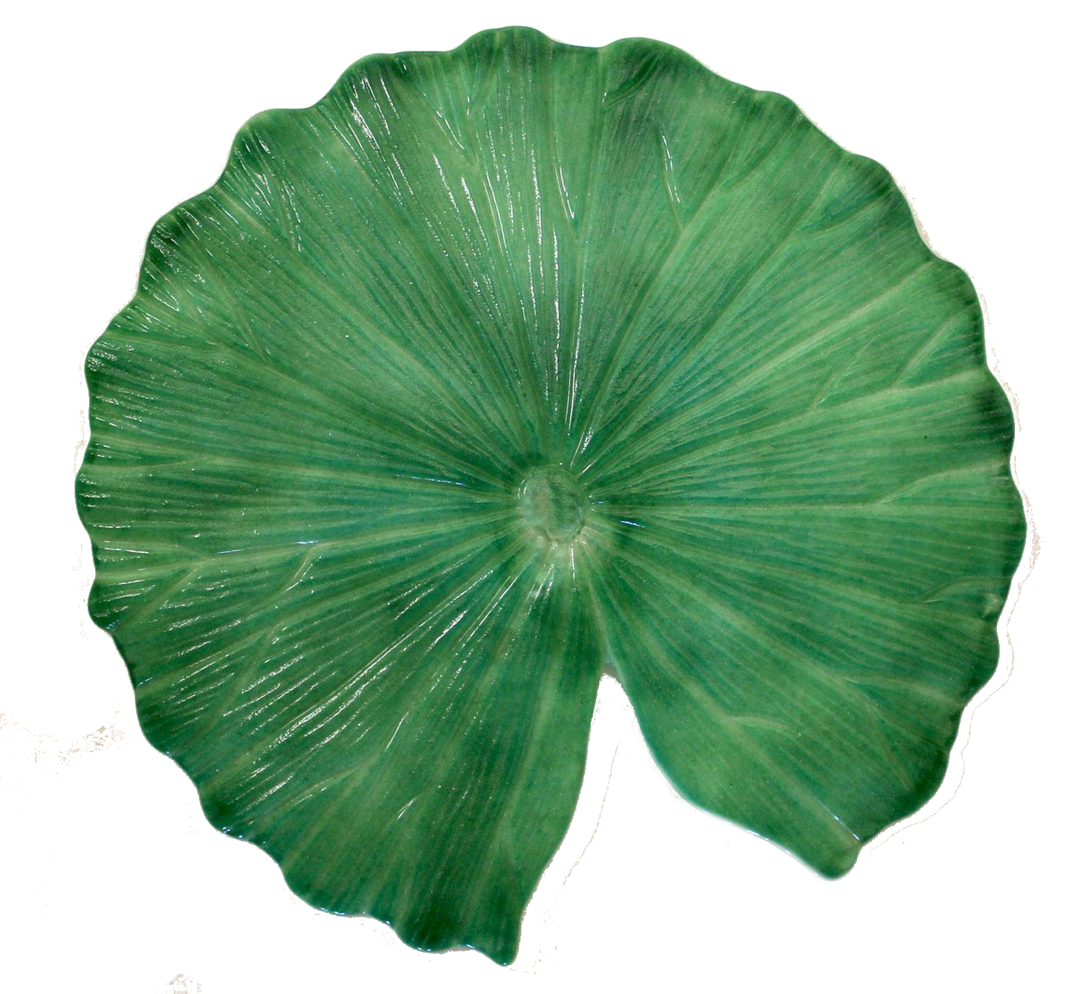

Notes:
Introduction slide

Slide 2

Notes:
1 - practice

Slide 3
Notes:
5 fish

Slide 4
Notes:
7

Slide 5
Notes:
16

Slide 6
Notes:
24

Slide 7
Notes:
52

Slide 8
Notes:
71

Slide 9
Notes:
105

Slide 10
Notes:
107

Slide 11
Notes:
116

Slide 12
Notes:
224

Slide 13
Notes:
252

Slide 14
Notes:
271

